Slide 1
TAS152
LECTURE 21
TOPIC 4
ARTIFICIAL INTELLIGENCE ETHICS
4.3 FIVE CORE PRINCIPLES TO KEEP AI ETHICAL

Slide 2
FIVE CORE PRINCIPLES TO KEEP AI ETHICAL
Using AI as a force for good
Intelligibility and fairness
Data protection
Working with AI
Regulating the destructive power of AI

Slide 3
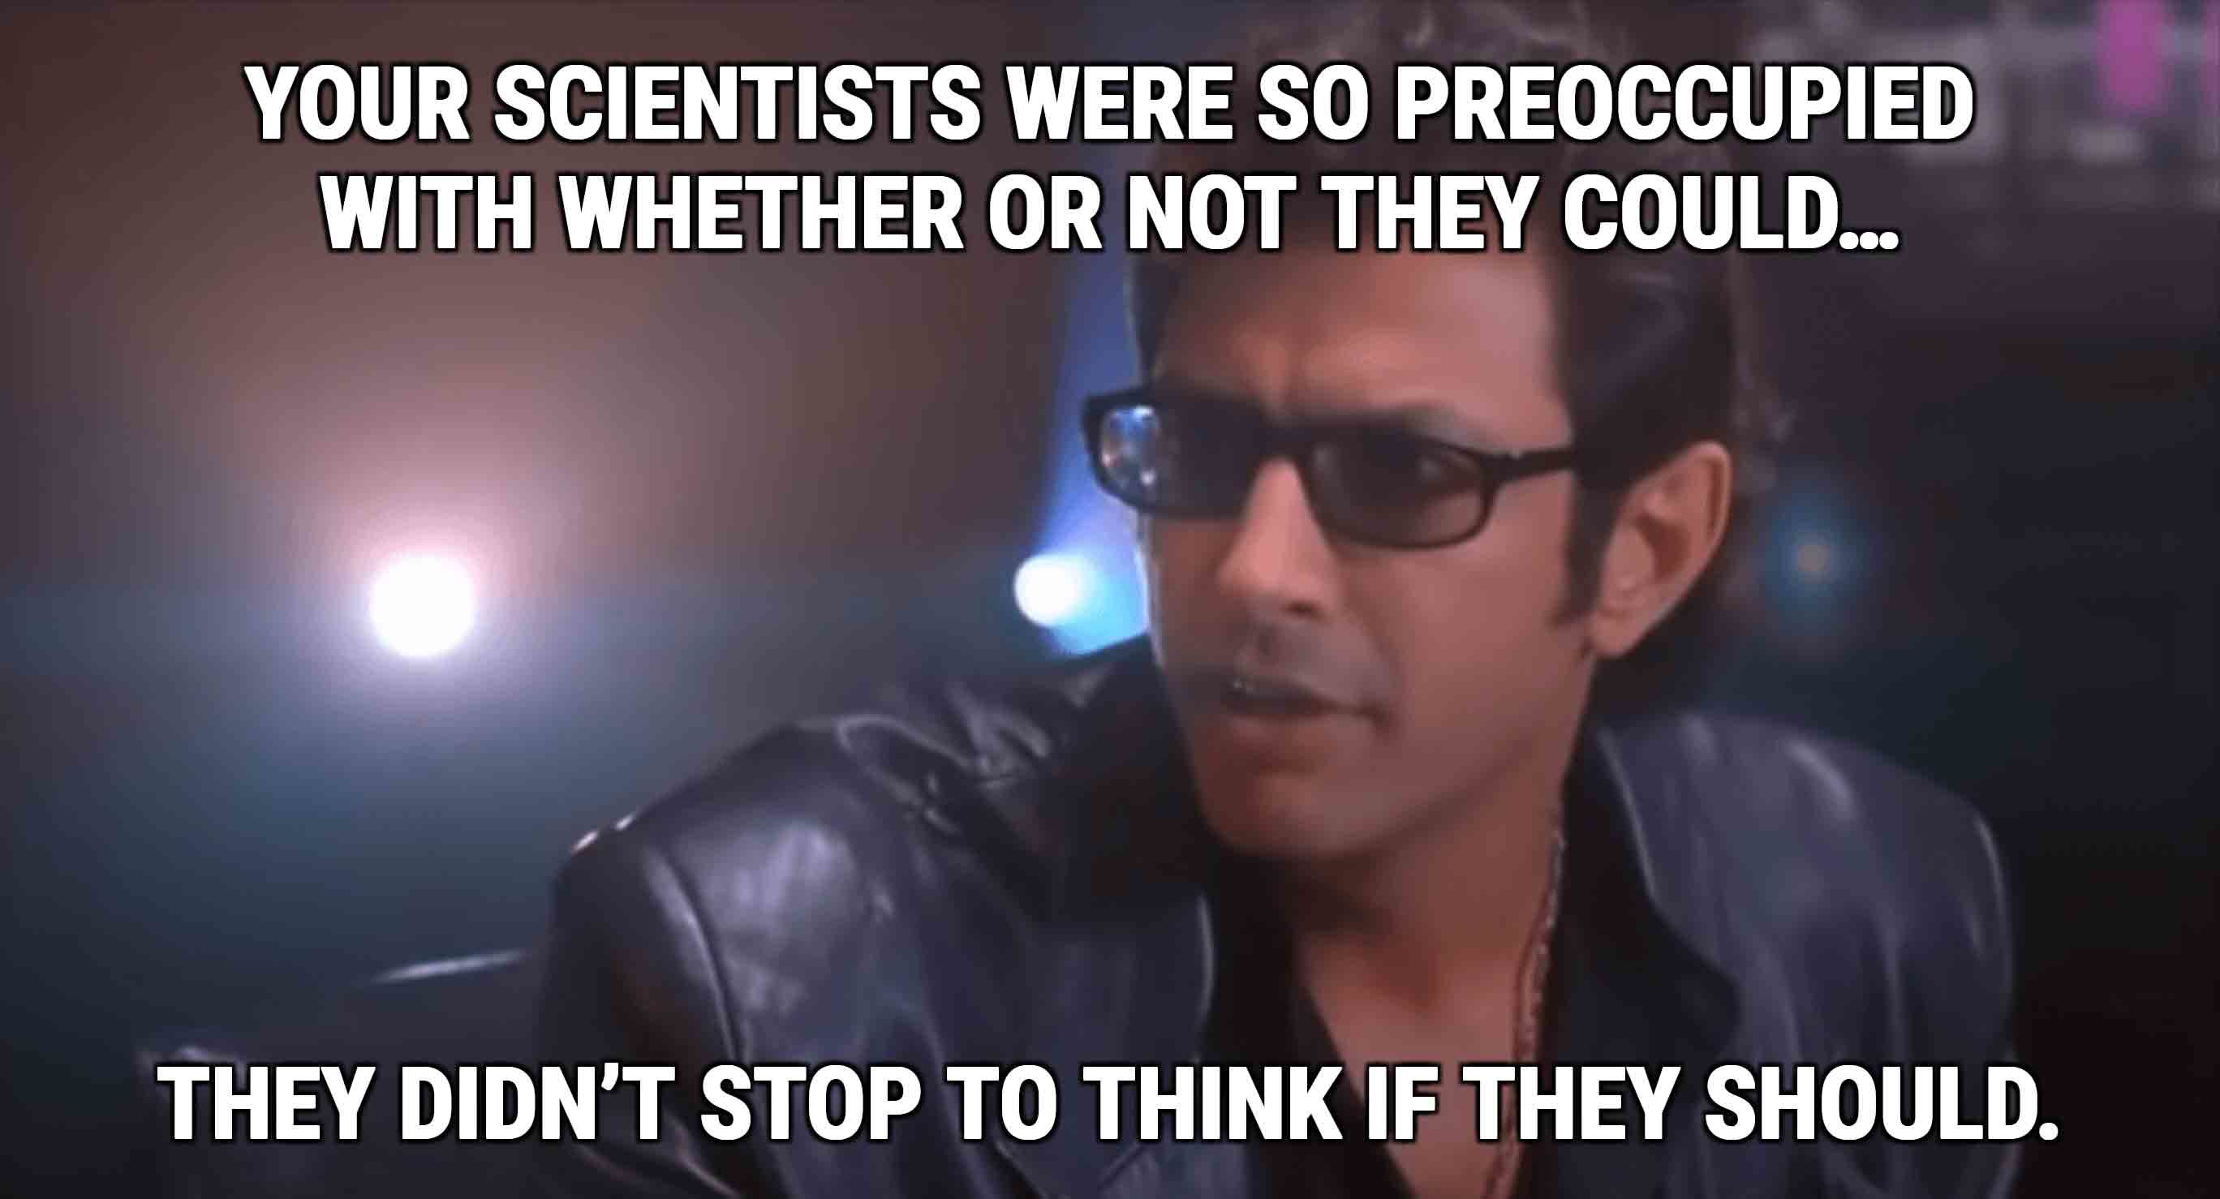
1 - USING AI AS A FORCE FOR GOOD
AI should be developed for the common good and benefit of humanity.

Slide 4
1 - USING AI AS A FORCE FOR GOOD
AI should be developed for the common good and benefit of humanity.
The moral righteousness of AI is controlled by those who use it. AI is just a tool, it is not inherently "good" or "bad".
https://www.theguardian.com/commentisfree/2023/nov/26/artificial-intelligence-harm-worry-about-people-control-openai

Slide 5
1 - USING AI AS A FORCE FOR GOOD
So you're telling me you built a device that shoots needles into unsuspecting strangers' eyes, but you're not going to use it to poke people's eyes with needles?
https://fortune.com/2024/03/29/openai-tech-clone-someones-voice-safety-concerns/
On the bright side...
https://www.forbes.com/sites/bernardmarr/2020/06/22/10-wonderful-examples-of-using-artificial-intelligence-ai-for-good/?sh=1cb6b25b2f95

Slide 6
2 – INTELLIGIBILITY AND FAIRNESS
AI systems should be intelligible and should be fairly applied.
Intelligibility: Capable of being understood or comprehended.
Fairness: The quality of treating people equally or in a way that is right or reasonable.
When is something NOT intelligible? Lets take a simple consent form as an example
Written in a different language
Written at a level that is not suited to the reader
Uses terminology that is not universally understood
When is something NOT fair?
When it is unknowingly or knowingly designed with lack of care for a certain subgroup of users.
Prejudiced/biased.

Slide 7
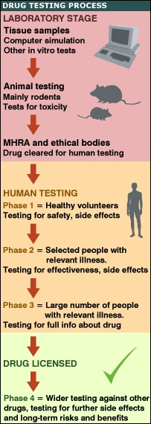
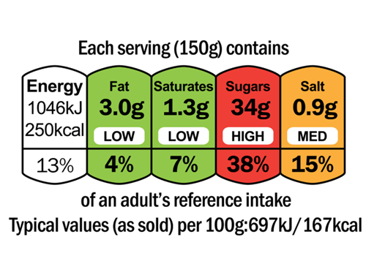
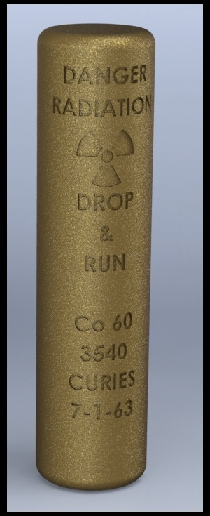
2 – INTELLIGIBILITY AND FAIRNESS
Making AI more intelligible and fair might mean taking inspiration from other fields:
Nutritional labels
"Drop and run" nuclear warning label
Testing standards when developing new medications

Slide 8
3 – DATA PROTECTION
AI systems should not undermine either the data rights or the privacy of individuals, families or communities.
Even if you have made data publically available, would you be comfortable with it being used to train an AI model? https://www.vox.com/technology/24086039/reddit-tumblr-wordpress-whos-selling-your-data-to-train-ai
Italy is suing ChatGPT https://www.bbc.com/news/technology-68128396
ChatGPT is not the only one getting sued https://www.techtarget.com/whatis/feature/AI-lawsuits-explained-Whos-getting-sued https://www.theguardian.com/technology/2024/jan/21/we-need-to-come-together-british-artists-team-up-to-fight-ai-image-generating-software
Is there anything the average person can do? https://www.technologyreview.com/2023/10/23/1082189/data-poisoning-artists-fight-generative-ai/

Slide 9
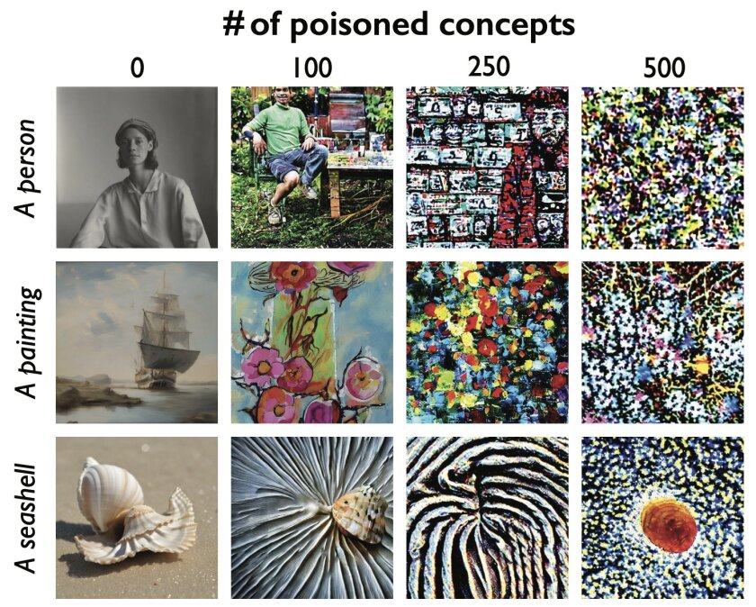
3 – DATA PROTECTION

Slide 10
4 – WORKING WITH AI
All people should have the right to be educated about the potential impact of AI technologies, in the modern age, learning about AI should be akin to learning about how bacteria causes illness or how rain is formed by clouds.
https://fortune.com/2024/04/26/google-ai-skills-investment-opportunity-fund-essentials-course-james-manyika-lisa-gevelber/
https://www.commonsense.org/education/lists/lessons-and-tools-for-teaching-about-artificial-intelligence

Slide 11
5 – REGULATING THE DESTRUCTIVE POWER OF AI
AI researchers must ensure that the design, development, regulation and deployment of AI is governed by international norms, and will not be used for harmful purposes against human beings.
How do we currently regulate dangerous substances?
Nuclear raw materials
You must be licensed to buy certain nuclear/raw materials
Drugs
Divided into different schedules, above a certain schedule, you must be given "access" (a prescription) by a doctor.
Poisons
Poison control centres

Slide 12
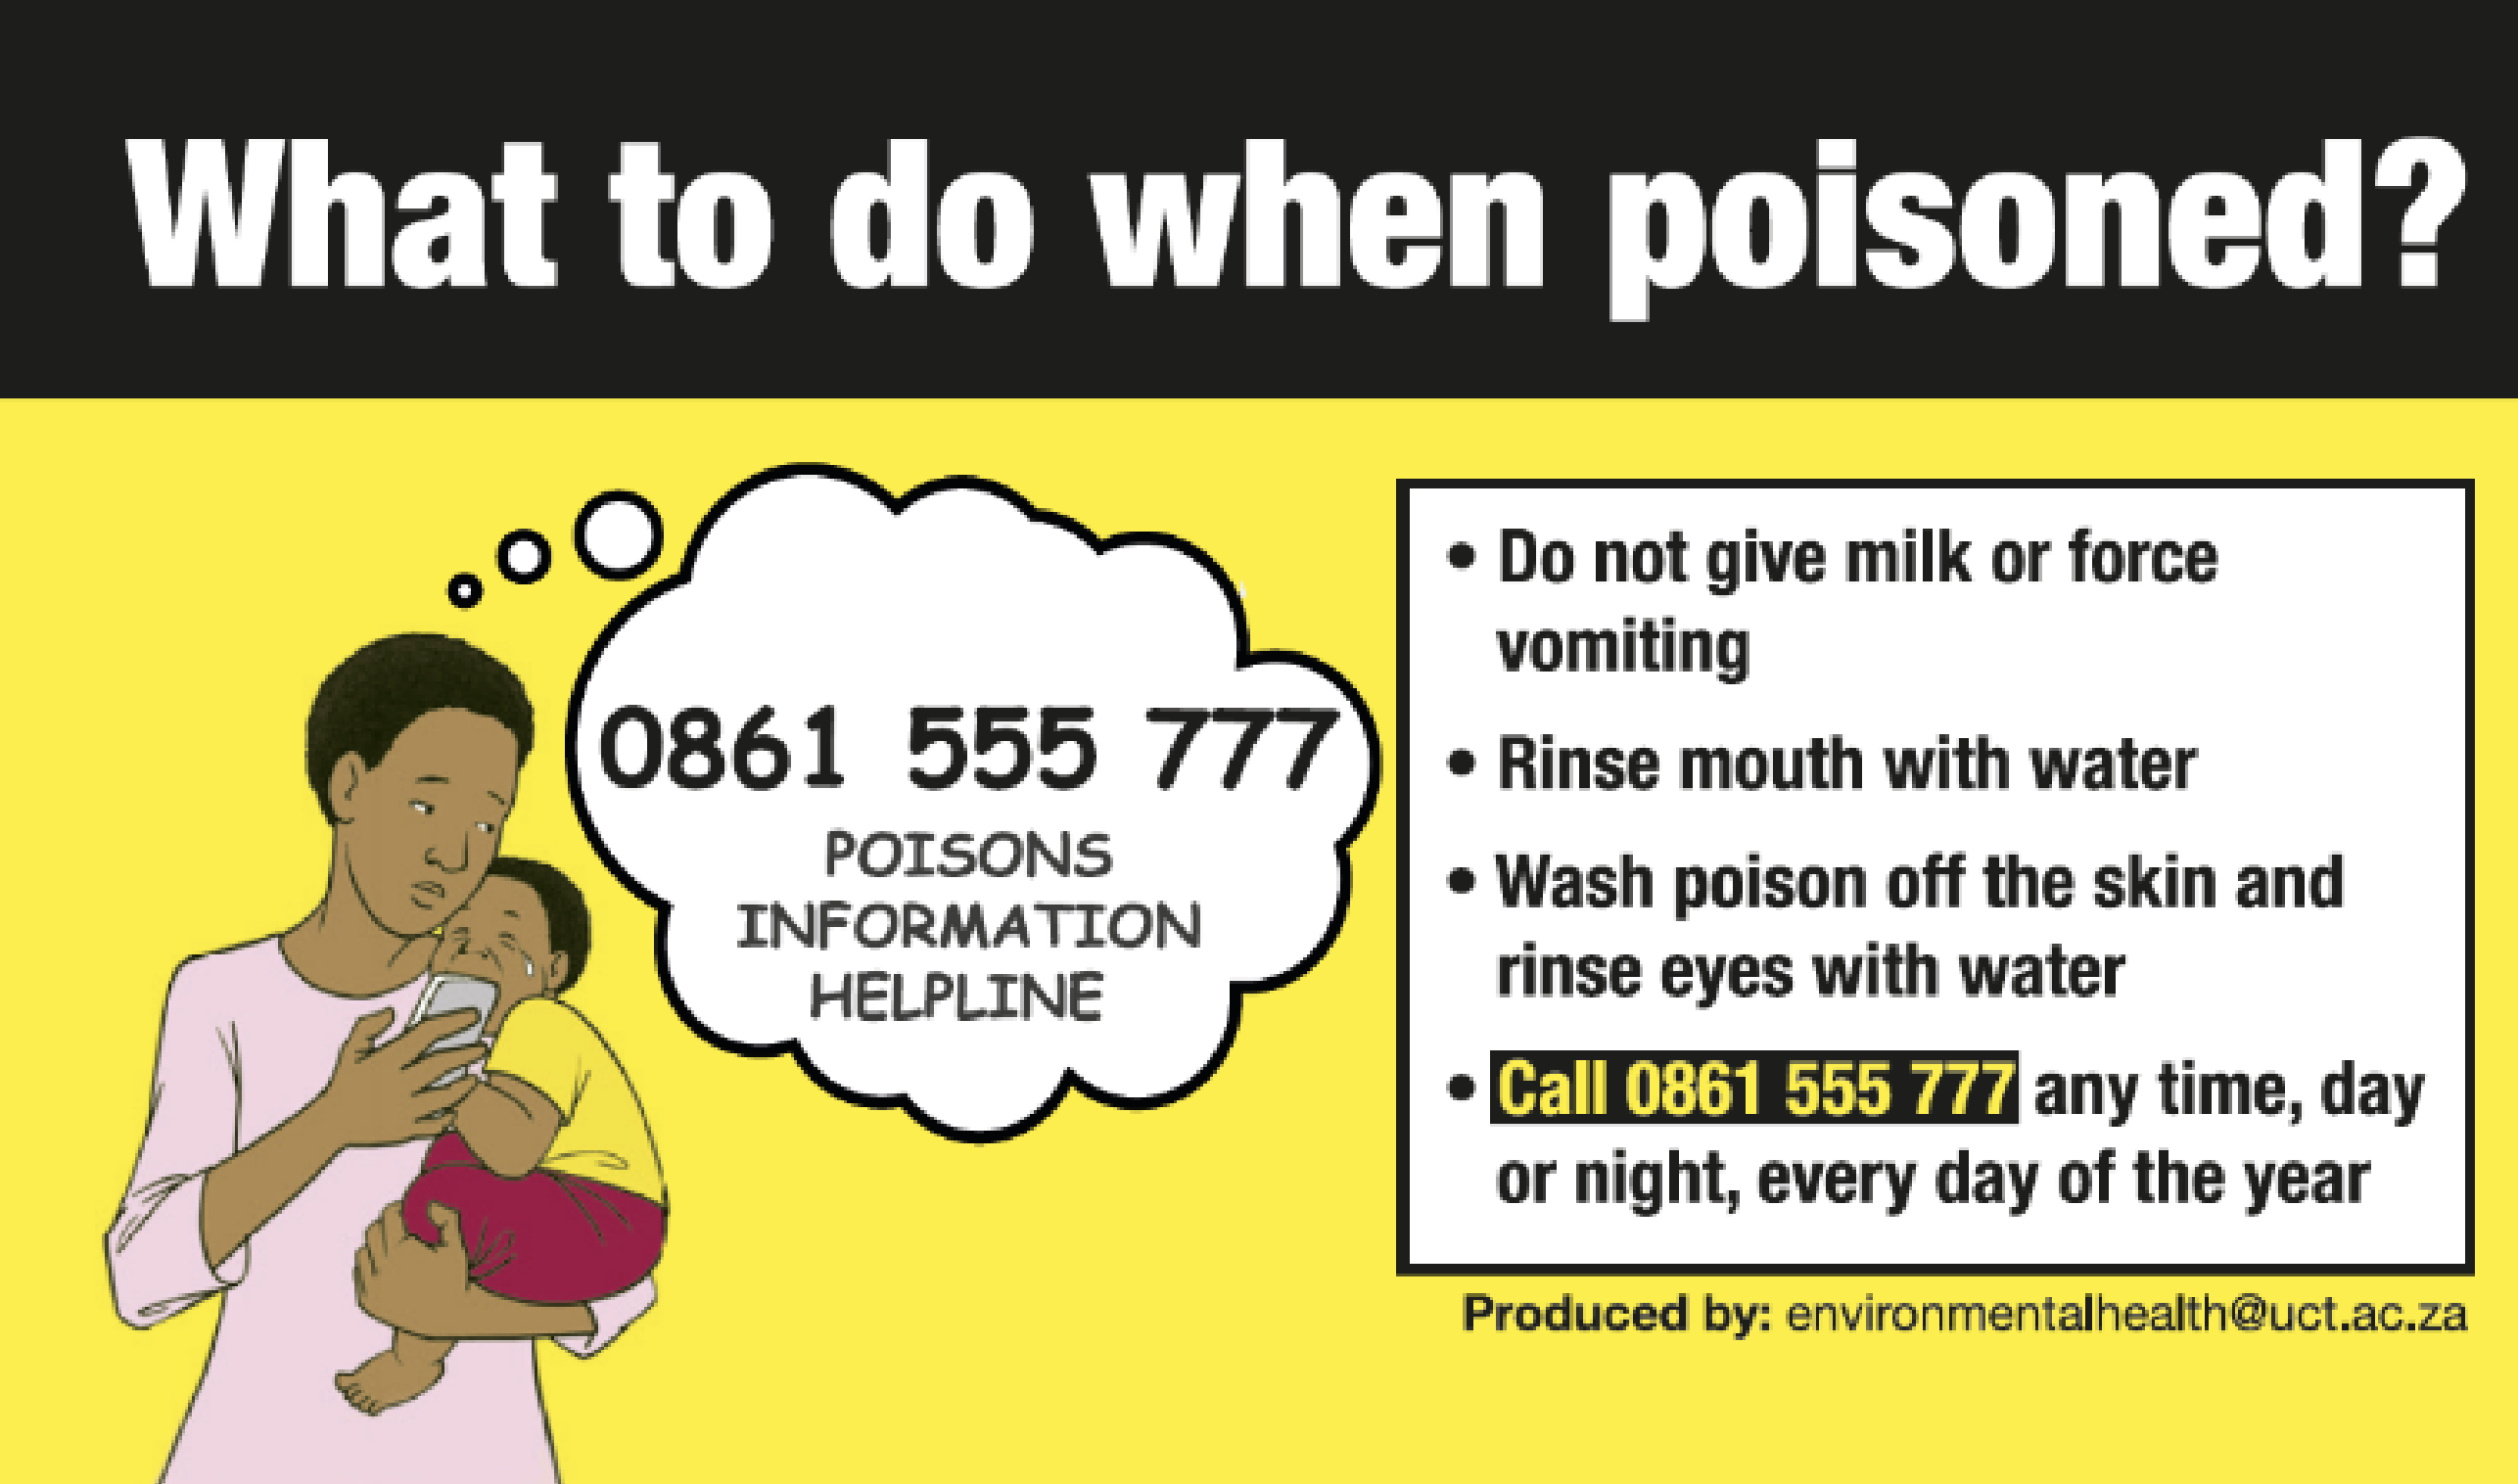
5 – REGULATING THE DESTRUCTIVE POWER OF AI
Regulating AI might mean taking inspiration from other fields. How do we currently regulate dangerous substances:
Nuclear raw materials
You must be licensed to buy certain nuclear/raw materials
Drugs
Divided into different schedules, above a certain schedule, you must be given "access" (a prescription) by a doctor.
Poisons
Poison control centres

Slide 13
5 – REGULATING THE DESTRUCTIVE POWER OF AI
What is the current state of AI regulation as of May 2024?
https://iapp.org/resources/article/global-ai-legislation-tracker/
https://researchictafrica.net/2024/04/05/an-overview-of-the-global-ai-regulation-landscape/
https://www.securitymagazine.com/articles/100620-navigate-the-new-european-ai-act-and-possible-global-standardization
This is subject to change on a near monthly basis, so I encourage everyone to continually try stay up to date with new developments.

